Slide 1
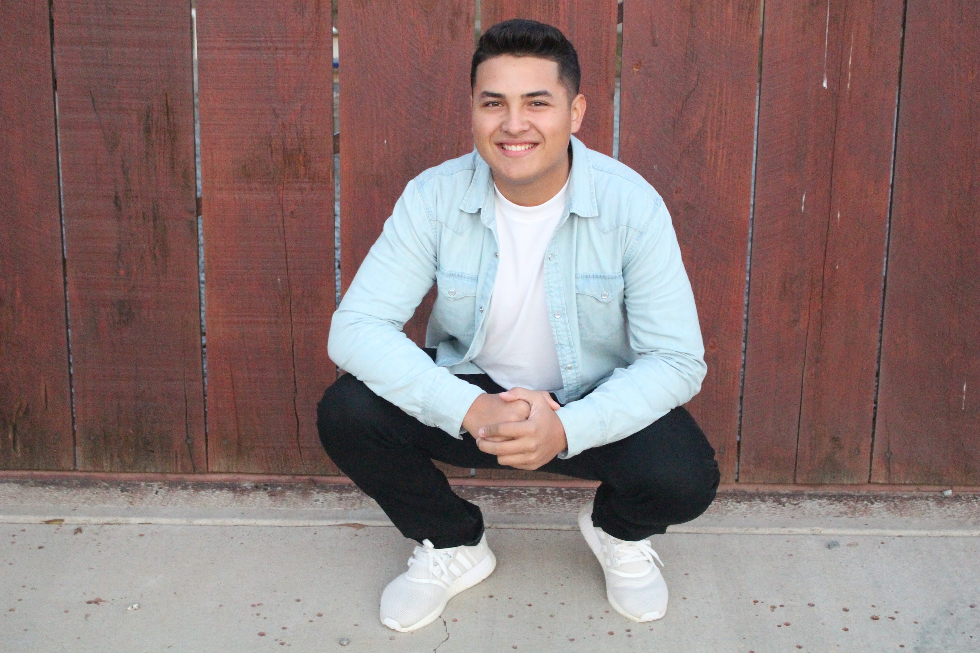
Jesus Valenzuela
Class of 2017

Slide 2
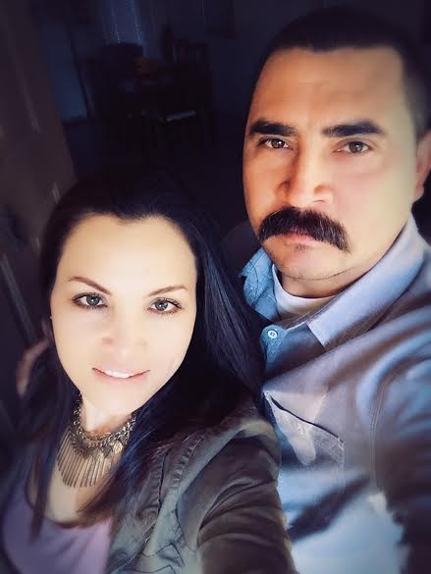
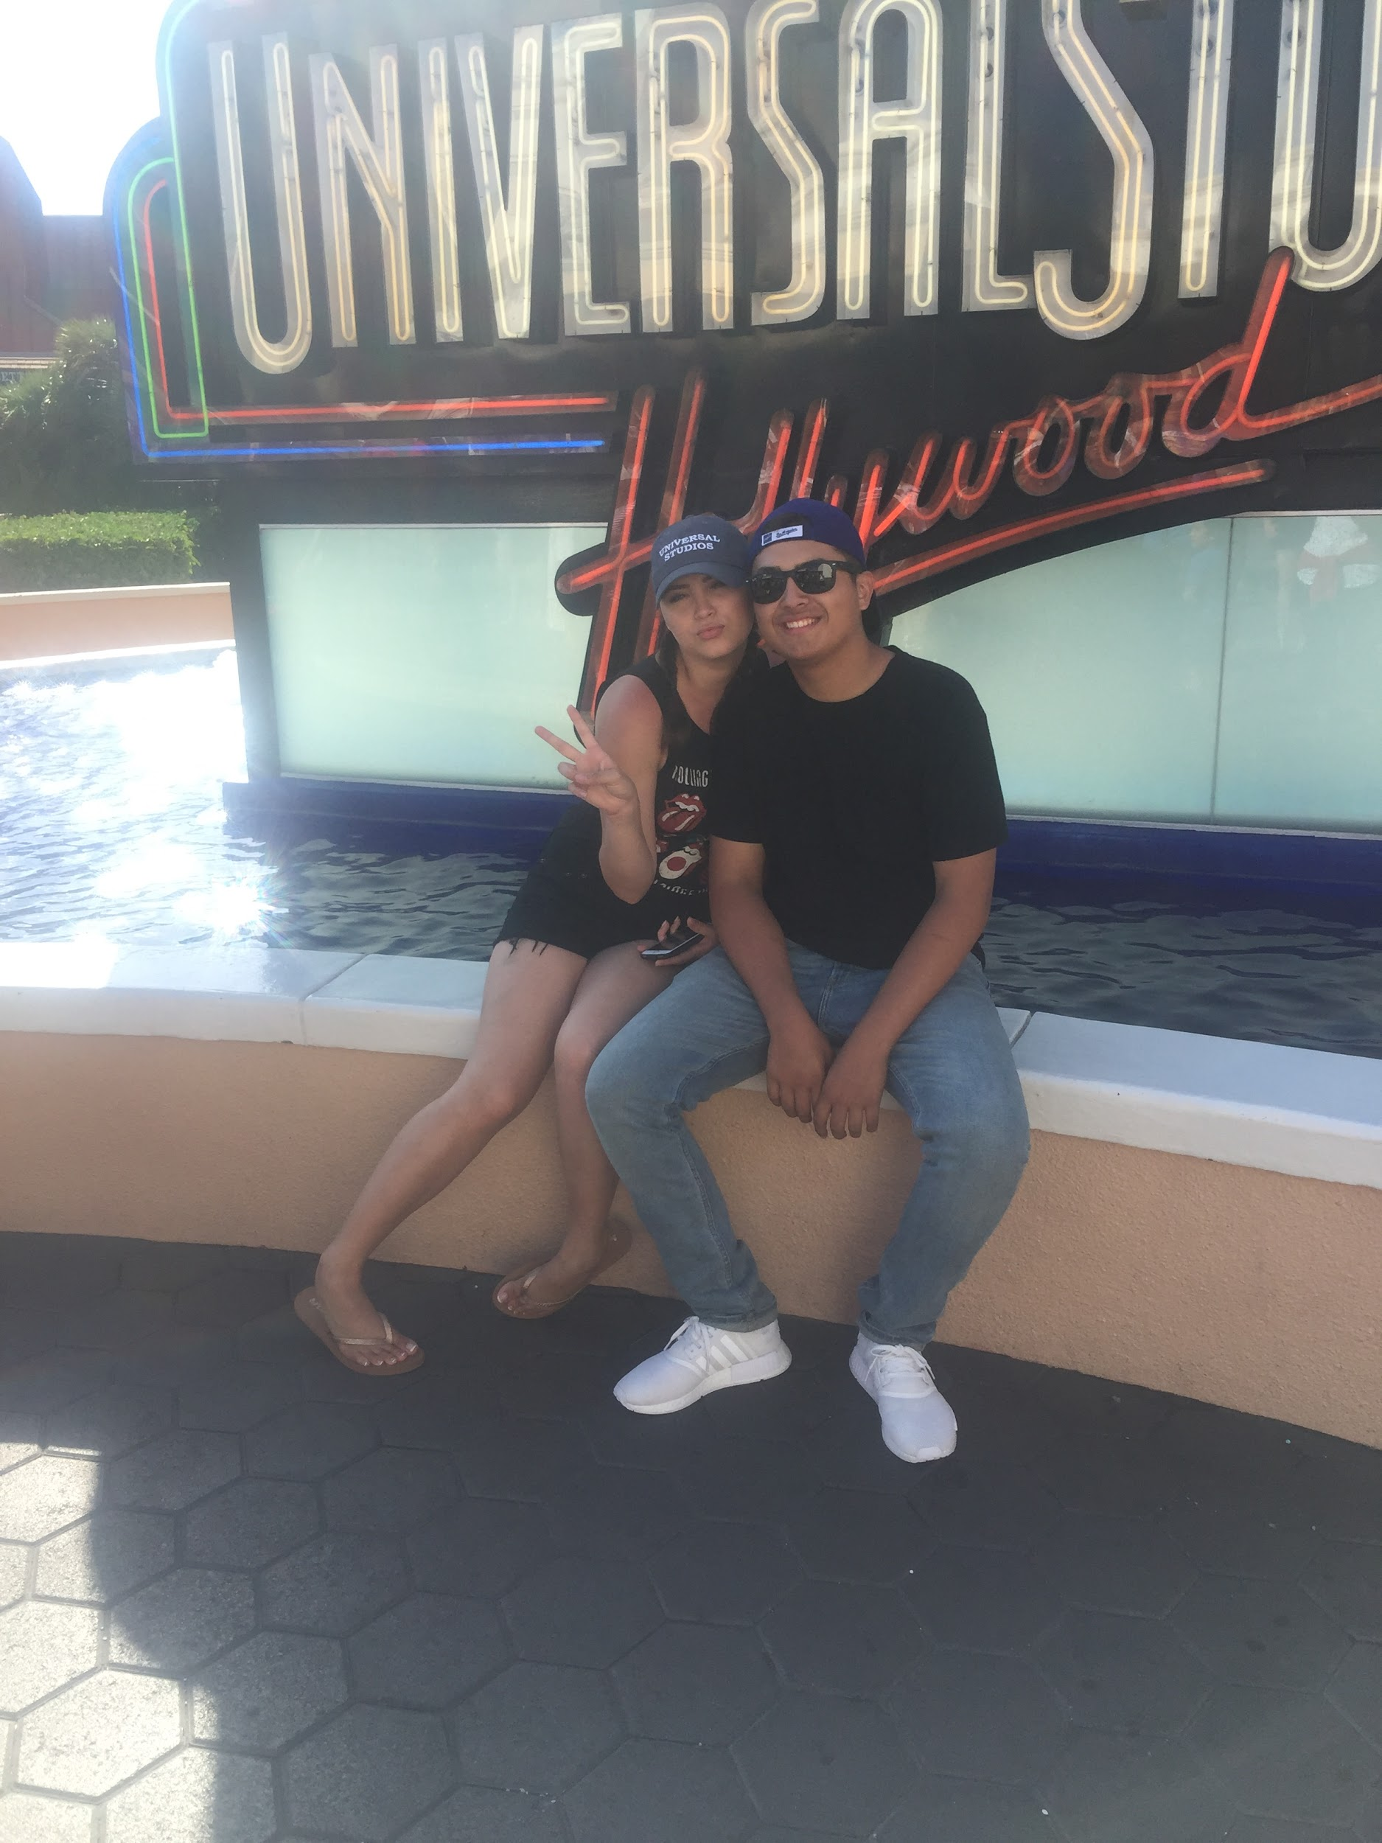
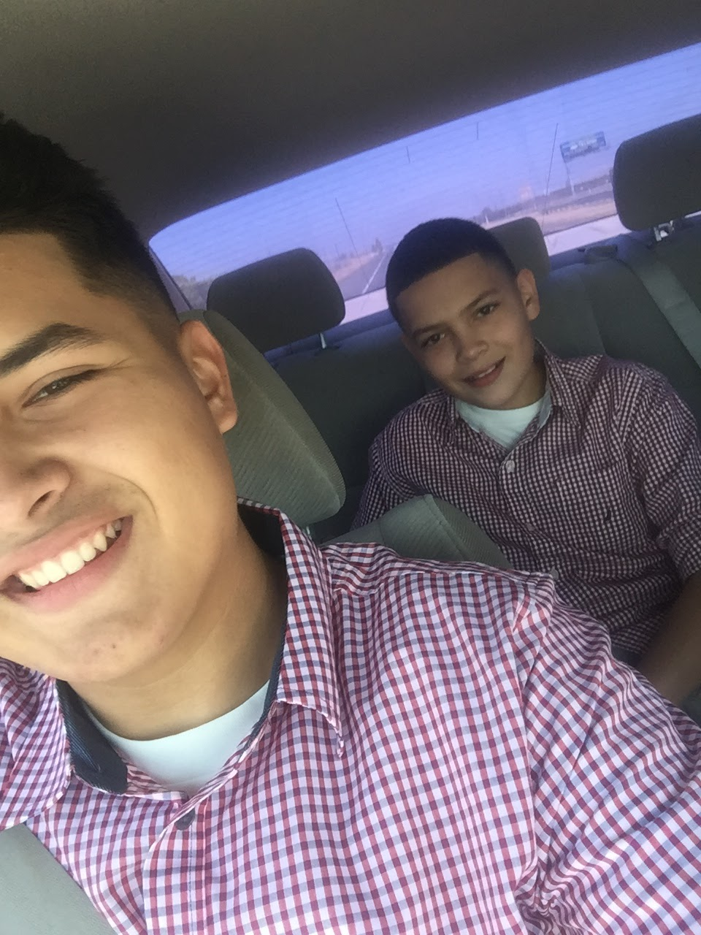
About me
Born in Lindsay, CA 1999
Two siblings in my family
I am the middle one out of 3
Two AMAZING parents
Notes:
First off I will be telling you a little about myself. I was born in Lindsay CA on October 10, 1999. I was raised my whole life here in Lindsay CA. My family and I are very out going, we are always together. I am the middle one out of 3. I have one brother and one sister that drive me crazy. My love for them is indescribable and wouldn’t trade them for anything, I love them with all my heart. My parents play a huge part in my life I am very grateful to have them by my side through thick and thin.They are very supporting and loving parents. Although, there has been several difficult times that we have had; we still manage to overcome those moments.

Slide 3
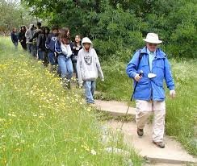
Clubs & Activities
LHS basketball
Involved in ASB
Scicon Counselor
Notes:
These activities and club throughout my high school year was awesome. Being a part of LHS and representing your school feels great because it shows who you are, it improves my type of responsibility, skills, and has made me feel better about myself. It’s been a privilege being involved with my campus. It’s something that I will definetly look back too and all I will have remaining will be memories.

Slide 4
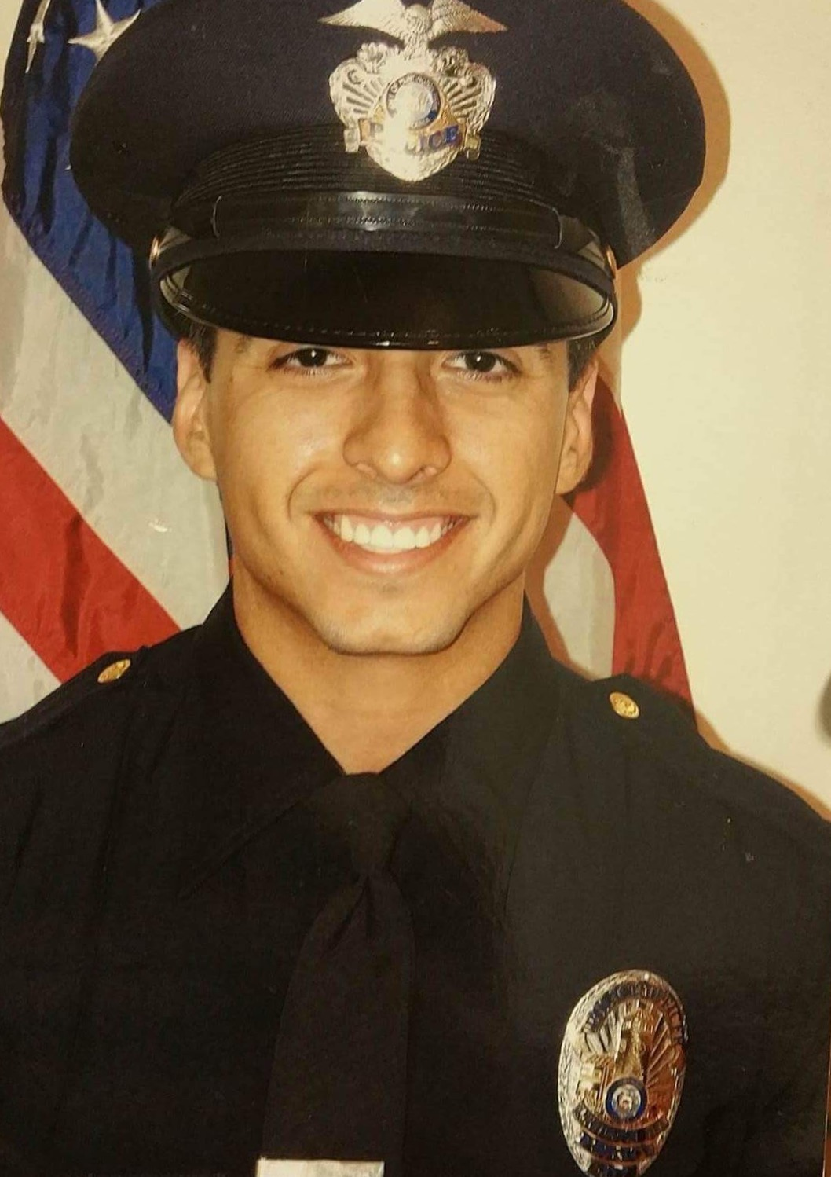
Job Shadow
Jose Almanza
California Highway Patrol
Requires speed, strength, and smartness
My future job
Notes:
I had the privilege to job shadow my dream job. Being a California High Patrol has been something that I’ve been wanting to be, ever since I was in the 5th grade. I've always wanted to follow my uncle because he has shown be what’s best for me since day 1. He motivated me and to this day I’m not giving up to what i’ve always wanted to become.

Slide 5
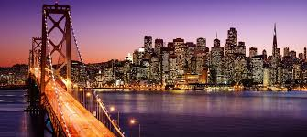
Future Plans
Attend COS and transfer to Fresno State
Major- criminology
Live in San Francisco Bay Area
Notes:
My plans after high school are to attend COS and then transfer to Fresno State. I plan on majoring in criminology and receive my bachelor's. After i have finished with my education i want to head out to the bay area because living right next to the beach would be AMAZING! Just imagine having nice view on the ocean every morning, i'll never get tired of it.

Slide 6
Leaving LHS
Thanks to all LF’S
Mr. Gutierrez
Performance base system
Notes:
So I’d like to take the moment and thank all the learning facilitators helping and pushing me to reach my dreams. One teacher that I’d like to point out will be Mr. Gutierrez. This learning facilitator wasn’t just one one of my teachers but he is also a role model. I’d like to thank him for taking his own time to help me to apply to colleges and scholarships and any other struggle that I had. PBS has helped me not only be independent but by meeting deadlines as well. With this being said this would help me a lot during college.

Slide 7
Thank you for your time!
Any questions?

